Slide 1

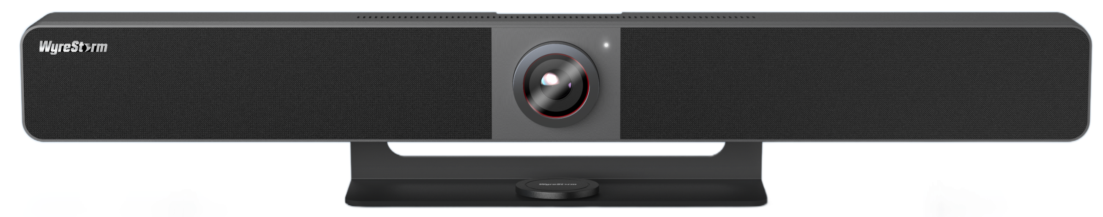

APO-VX20-UC v2
Product Guide
4K All-In-One Conference Video Bar & Switcher
Award-Winning Audio-Visual Solutions Manufacturer
Notes:
1. 更新封面，不需要展示产品；

Slide 2

Contents
Product Overview & Key Features
Why Choose Us?
Interface & Specifications
Typical Connection & Applications
Comparison with Previous Products
Competitor Analysis
Quick Installation Guide & Web UI Introduction
Q & A Session
Powerful · Reliable · Simple

Slide 3
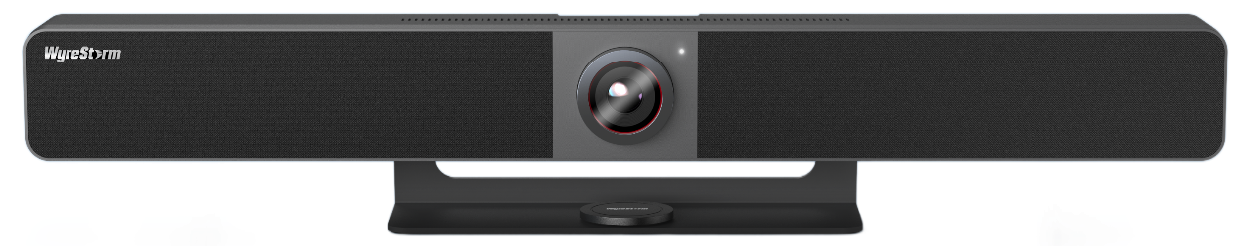
Product Overview
Apollo Series 4K All-In-One Conference Video Bar & Switcher
The APO-VX20-UC v2 is a next-generation premium conference video bar featuring an upgraded larger image sensor, enhanced AI tracking, a newly added wireless casting function, and dual 4K HDMI outputs for a professional video, audio, and wireless collaboration experience.​
Built with WyreStorm’s professional AV technology, the APO-VX20-UC v2 offers AI-powered tracking and noise suppression to ensure everyone is seen and heard clearly. Its plug-and-play USB-C interface supports simultaneous audio, video, and power delivery, while HDMI port enables flexible connectivity. Expandable with the APO-SKY-MIC, it adapts to rooms of various sizes while maintaining optimal performance and minimal setup complexity.
This video bar is ideal for small to medium-sized meeting rooms, effortlessly meeting diverse needs and enhancing overall efficiency.
Powerful · Reliable · Simple

Slide 4






Main Features
Comprehensive Input & Output Options
Equipped with both wired (HDMI, USB-C) and wireless (Dongle, AirPlay, Miracast) casting across dual 4K outputs, the APO-VX20-UC v2 ensures flexible connectivity for various devices — ideal for conference rooms, classrooms, and hybrid meeting environments.
Premium Audio System
Features 8 MEMS beamforming microphones with Acoustic Echo Cancellation (AEC), Automatic Gain Control (AGC), and Noise Suppression (ANS) powered by advanced AI algorithms, ensuring every participant is heard clearly. Dual 8W stereo speakers deliver powerful, room-filling sound.
USB-C All-in-One Connectivity The USB-C port provides 60W power delivery, video, and USB data transmission through a single cable, simplifying cabling and maintaining a clean, tidy workspace.
Expandable with Add-On Microphone
Supports up to 5 cascading APO-SKY-MIC units, extending voice pickup coverage for larger meeting spaces.
4K Camera with Advanced AI Features
The built-in 4K UHD camera delivers crystal-clear images and features advanced AI capabilities, including Auto Framing, Presenter Tracking, Speaker Tracking, and Individuals Gallery.
Flexible Control Options
Supports control and configuration via remote control, Web GUI, or API for convenient and efficient operation.
Wireless Casting Support
With the APO-DG2 or APO-DG2-PRO, users can easily enable wireless conferencing using the video bar’s camera with a single button press.
Powerful · Reliable · Simple

Slide 5
Why Choose Us: 1. Next Generation All-In-One Collaboration Experience
Transform your meeting spaces with the upgraded Apollo Video Bar — combining a wireless presentation and conference switcher with an all-in-one video bar in a single solution.
Powerful 4K AI Camera
High-Fidelity Audio Performance
Built-in 4K UHD camera delivers crystal-clear images and features advanced AI capabilities, including Auto Framing, Presenter Tracking, Speaker Tracking, and Individuals Gallery.
Dual 8W stereo speakers with bass enhancement and 8x beamforming microphone array ensure crystal-clear, natural sound — even in larger rooms.
Expandable Audio Pickup
Supports easy expansion of microphone pickup coverage using APO-SKY-MIC through Ethernet cabling.
Powerful · Reliable · Simple

Slide 6
Why Choose Us: 2. Wireless Presentation and Conference in Bar
Empowers hybrid workspaces with versatile wired and wireless connectivity, designed for simplicity and high performance.
Multi-Input Selection
Dual Output Connectivity
Equipped with both wired (HDMI, USB-C) and wireless (Dongle, AirPlay, Miracast) casting, allows effortless switching between laptops, media devices, and presentation inputs.
Supports dual 4K HDMI outputs, allowing different contents on two screens. On a single display, it enables dual views, giving users more information at a glance and enhancing collaboration.
One-Click Wireless Casting
Compatible with WyreStorm APO-DG2/APO-DG2-PRO USB-C dongles for one-click wireless casting and wireless conferencing, eliminating connection delays and setup time.
Powerful · Reliable · Simple

Slide 7
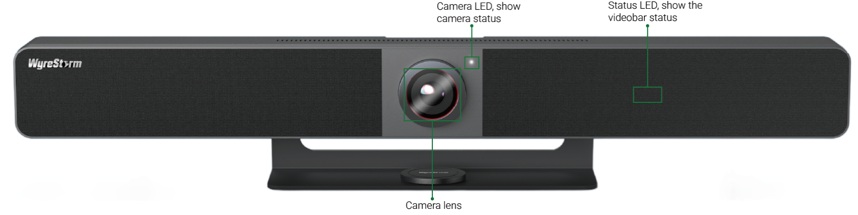
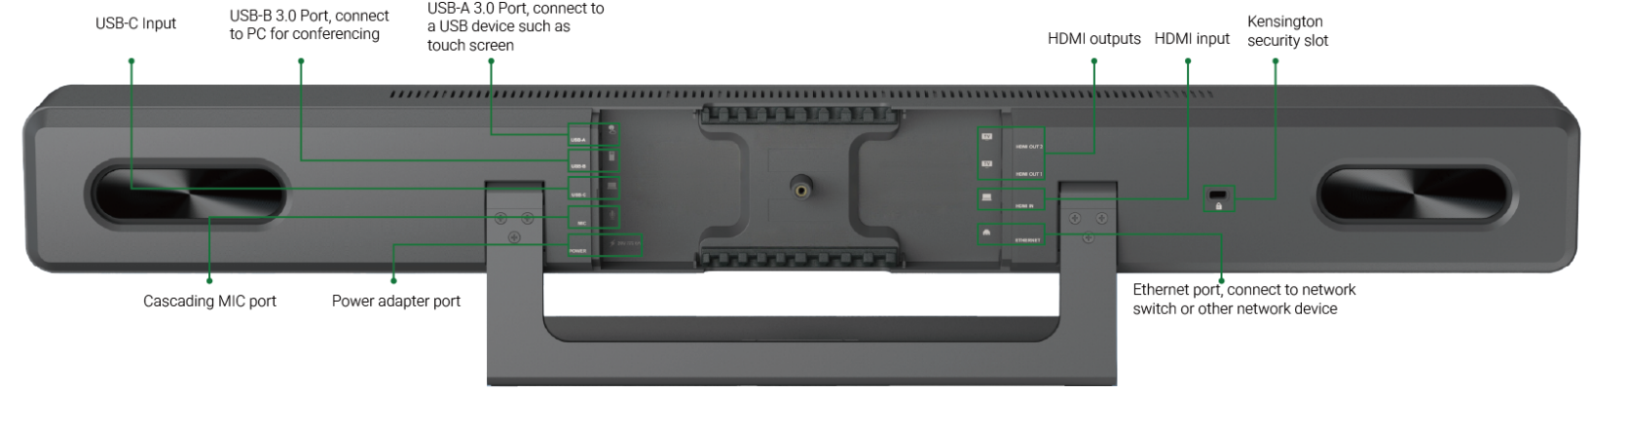
Interface of the Product
Front Panel
Featuring:
Wireless Casting
When used with APO-DG2/APO-DG2-PRO, users can perform wireless casting and wireless conferencing seamlessly.
Dual 4K Output
Two HDMI outputs, with HDMI out 1 supporting up to 4K@60Hz. Supports dual-view when using a single display.
Rear Panel
Powerful · Reliable · Simple

Slide 8
Specifications & Packing List
Main Specifications
Camera | Lens | Fixed Focus, DFOV 120°
 | Sensor | 1/1.8’’, 8M effective pixels, Up to 4K@30fps
 | Output Encoding | MJPEG/YUY2/H.264/H.265 | UVC 1.1
 | ePTZ | Supported, 5 x Digital Zoom
 | AI Tracking | Auto Framing / Speaker Tracking / Presenter Tracking /Individuals Gallery
Speakerphone | Microphone | 8 x Linear microphone arrays; Pick-up Range: 8m(Extendable with APO-SKY-MIC)
 | Speaker | 2 x 8 W
 | AI Technology | AGC, AEC, ANS
Video | Video Resolution | USB-C IN: Up to 4K@30Hz; HDMI IN: Up to 4K@30Hz, HDCP 1.4; HDMI OUT 1: Up to 4K@60Hz, HDCP 2.3; HDMI OUT 2: Up to 4K@30Hz, HDCP 2.2
Wireless Collaboration | Wireless Casting | Miracast, AirPlay, APO-DG2/APO-DG2-PRO
 | Wireless Conferencing | APO-DG2/APO-DG2-PRO
USB | USB | USB-C 3.0 host (60W charging) USB-B 3.0 host USB-A 3.0 device (1.25A current output)
Communication & Control | Control Method | Web UI, API, Remote Controller
 | Security Protocols | HTTPS, SSH, 802.1x
What’s in the Box?
1x DC power adapter 20V/6A with US/UK/EU/AU
1x 5m HDMI cable
1x 5m USB-A to USB-B cable
1x Remote controller
1x Magnetic lens cap
1x Wall Mounting Kit
1x Desktop stand
1x QSG
1x USB to RJ45 adapter(APO-MIC-EXT)
Powerful · Reliable · Simple

Slide 9
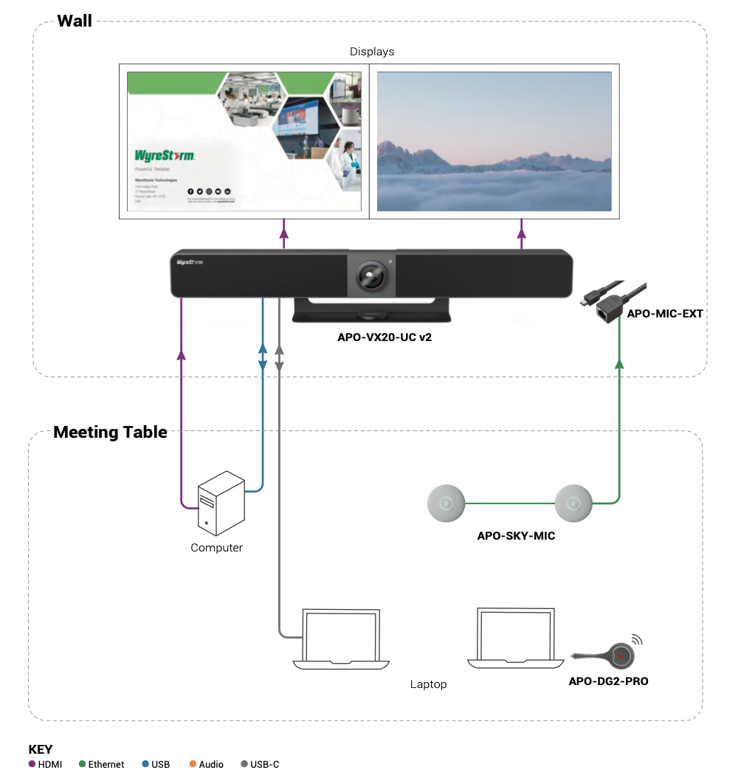
Typical Connection & Applications
The APO-VX20-UC v2 is a premium conference video bar that integrates a video switcher, speakerphone, and camera into a single device, delivering everything you need for video presentations and remote conferencing. Please refer to the typical connection diagram below.

Slide 10
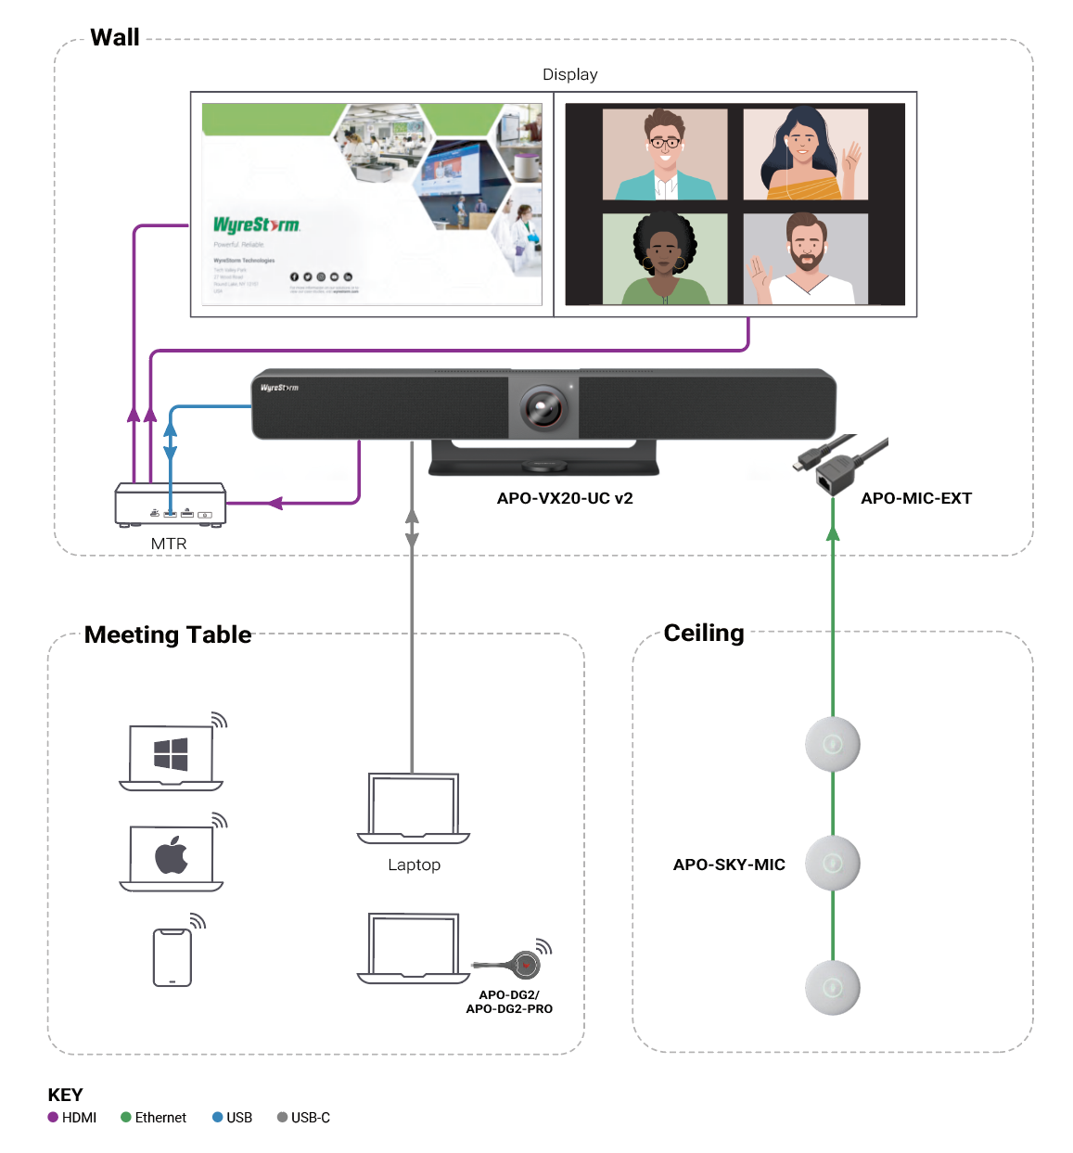
Typical Connection & Applications
Application Scenario 1: Medium Conference Room with MTR
This solution integrates the APO-VX20-UC v2 with a Microsoft Teams Room (MTR) system, creating an efficient and intelligent meeting environment. The all-in-one video bar ensures high-fidelity audio, crystal-clear 4K video, and seamless USB-C connectivity for BYOD collaboration.
Key Benefits Include:
Multiple Casting Methods: Simplifies presentations with various casting options.
All-In-One Design: Combines camera, microphones, and speakers in one sleek unit.
Flexible Connectivity: Supports USB-C and HDMI for versatile source connections.
Enhanced Audio Coverage: Compatible with APO-MIC-EXT and APO-SKY-MIC for scalable microphone expansion.
Seamless Wireless Casting: USB-C dongle plug-and-play connection for quick casting and conferencing.

Slide 11
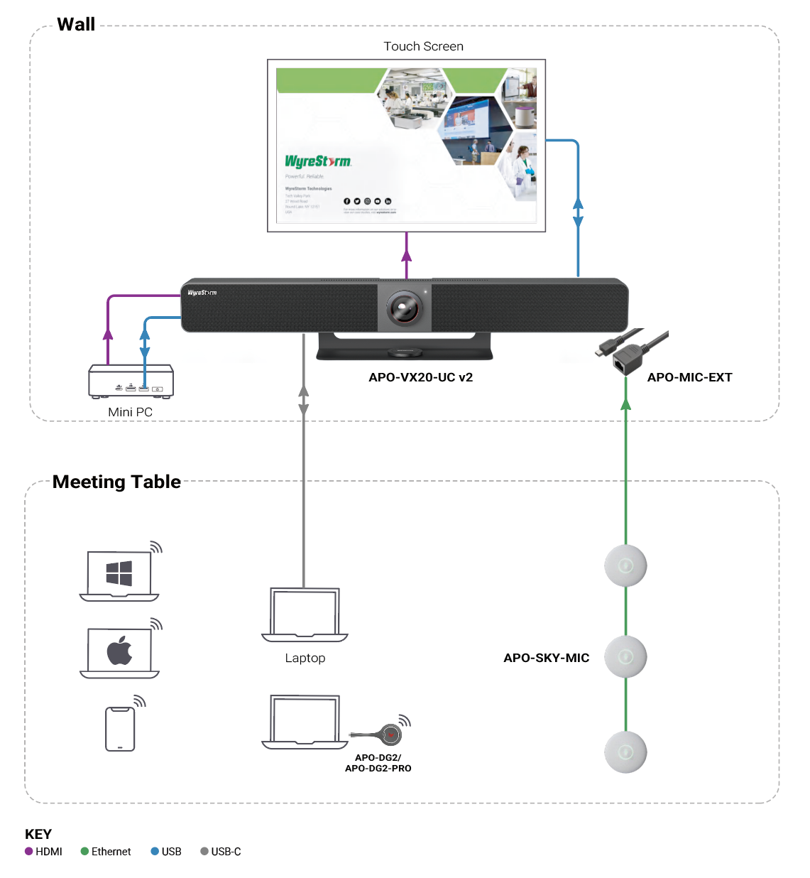
Typical Connection & Applications
Application Scenario 2: Medium Meeting Room with Touch Screen
This configuration combines the APO-VX20-UC v2 with an interactive touch display, providing a highly engaging and collaborative meeting experience. Participants can easily share content, control presentations, and connect their own devices for interactive collaboration.
Key Benefits Include:
Multiple Casting Methods: Simplifies presentations with various casting options.
All-In-One Design: Combines camera, microphones, and speakers in one sleek unit.
Flexible Connectivity: Supports USB-C and HDMI for versatile source connections.
Enhanced Audio Coverage: Compatible with APO-MIC-EXT and APO-SKY-MIC for scalable microphone expansion.
Seamless Wireless Casting: USB-C dongle plug-and-play connection for quick casting and conferencing.

Slide 12
WyreStorm Video Bars Comparison
Features​ |  | APO-VX20-UC v2​ | APO-VX20-UC​ | HALO-VX10 v2​
Camera​ | Sensor​ | 1/1.8'' | CMOS | 8M​ | 1/2.5'' | CMOS | 8M​ | 1/2.7'' | CMOS | 8M​
 | DFOV​ | 120°​ | 120°​ | 120°​
 | Digital Zoom​ | 5x​ | 5x​ | 5x​
 | Max. Camera Resolution​ | 4K@30fps​ | 4K@30fps​ | 4K@30fps​
 | AI Tracking Functions​ | Auto Framing, Speaker Tracking, Presenter Tracking, Individuals Gallery​ | Auto Framing, Speaker Tracking, Presenter Tracking​ | Auto Framing, Speaker Tracking, Presenter Tracking​
Video​ | Max. Video Output Resolution​ | 4K@60Hz 4:4:4​ | 4K@30Hz 4:4:4​ | No​
 | Video Inputs​ | 1x USB-C & 1x HDMI​ | 1x USB-C & 1x HDMI​ | No​
 | Video Outputs​ | 2x HDMI​ | 1x HDMI​ | No​
 | Wireless Casting​ | Airplay & Miracast & APO-DG2/APO-DG2-PRO​ | Airplay & Miracast & APO-DG1​ | No​
 | Wireless Conferencing​ | Yes, with APO-DG2/APO-DG2-PRO​ | No​ | No​
 | Dual View​ | Yes​ | Yes​ | No​
Audio​ | Voice Picking up Distance​ (Without extension mics)​ | up to 8m​ | up to 5m​ | up to 5m​
 | Speaker ​ | 2x 8W​ | 2x 8W​ | 2x 3W​
 | Extension Microphones ​ | 5x APO-SKY-MIC​ | 5x APO-SKY-MIC​ | 3x HALO-COM-MIC​
 | 3.5mm Analog Audio Out​ | No​ | No​ | Yes​
Others​ | USB 3.0​ | Yes​ | Yes​ | Yes​
 | Remote Control​ | Yes​ | Yes​ | No​
Notes:
修改表格从哪火速

Slide 13
Comparison with Other Competitors
Features |  | Wyrestorm APO-VX20-UC v2 | Barco ClickShare Bar Pro | Yealink A40 | Neat Neat Bar Pro
Camera | Max. Camera Resolution | 4K@30fps | 4K@30fps | 4K@30fps | 1080p
 | DFOV | 120° | 120° | 120° | 120°
 | AI Tracking | Auto Framing Speaker Tracking Presenter Tracking Individuals Gallery | Auto Framing Speaker Tracking Composition Mode | IntelliFocus Auto Framing Speaker Tracking Smart Gallery (Zoom only) | Adaptive Group Framing Dynamic Individual Framing Dynamic Speaker Focus
Video | Video Input | 1x HMDI 1x USB-C(60W charging) | 1x USB-C | 2x USB-C | 1x HDMI 1x USB-C
 | Max. Input Resolution | 4K@30Hz | 4K@30Hz | 4K@30Hz | 4K
 | Video Output | 2x HDMI | 1x HDMI & 1x USB-C | 2x HDMI | 3x HDMI
 | Max. Output Resolution | 4K@60Hz | 4K@30Hz | 4K@30Hz | 4K
Audio | Mics Array | 8x MEMS mics | 6x MEMS mics | 8x MEMS mics | 16x MEMS mics
 | Audio Pickup | Up to 8m (Expandable up to 5 APO-SKY-MIC) | Up to 4m | Up to 6m | Not Given (Support mic extension)
 | Speaker | 2x 8W | 2x 10W | 2x 10w | 3x speakers
Wireless Collaboration | Wireless Casting | Miracast, Airplay, Dongle | Miracast, Airplay, Google Cast, Dongle | No | No
 | Wireless Conferencing | APO-GD2/APO-DG2-PRO | Dongle or App | No | No
 | Max. Wireless Conferencing Resolution | 1080P30Hz | 720P15Hz | No | No

Slide 14

Quick Installation Guide
Connect and Power up: Connect the power supply and other cables, then turn on the video bar.
Choose Your Installation Method: Select a suitable installation method: table-top, on-display, or wall mount. For wall mounting, use the included brackets and ensure the video bar is securely and properly leveled. The bar can be mounted above or below the display as required.
Wired Connection: For wired conferencing and screen sharing, connect your laptop using USB-C, or HDMI with USB, to access video, audio, camera, and USB peripherals.
Wireless Casting & Dongle Pairing: Wirelessly cast content using built-in AirPlay or Miracast, or pair the optional APO-DG2 / APO-DG2-PRO USB-C dongle. Insert the dongle into the VX20 v2 USB-C port to pair, then plug it into your laptop and press the button to start wireless casting
Powerful · Reliable · Simple

Slide 15

Introduction of Web Configuration Interface
The key settings and configurations you can perform are as follows:
Camera & Tracking Settings: AI tracking modes (Auto Framing, Speaker Tracking, Presenter Tracking, Individuals Gallery), camera presets, and image settings.
Video Settings: HDMI output resolution, EDID behavior, and CEC display control.
General Settings: IP settings (DHCP/Static), device name, Wi-Fi hotspot name, access code, and login security.
Wireless & BYOD Settings: Wireless casting enable/disable, BYOD mode configuration, Wi-Fi parameters, and dongle pairing support.
Powerful · Reliable · Simple

Slide 16

Final Thoughts
Q & A Session
Got questions? Don’t hesitate to ask away.
Powerful · Reliable · Simple

